Slide 1
Sztuczne sieci neuronowe w Keras

Slide 2

Agenda
Keras i Tensorflow
Keras w 30 sekund
Konwolucyjna sieć neuronowa
Transfer learning
Ważne techniki
Dropout
Optymizers

Slide 3
Machine learning building blocks
1

Slide 4
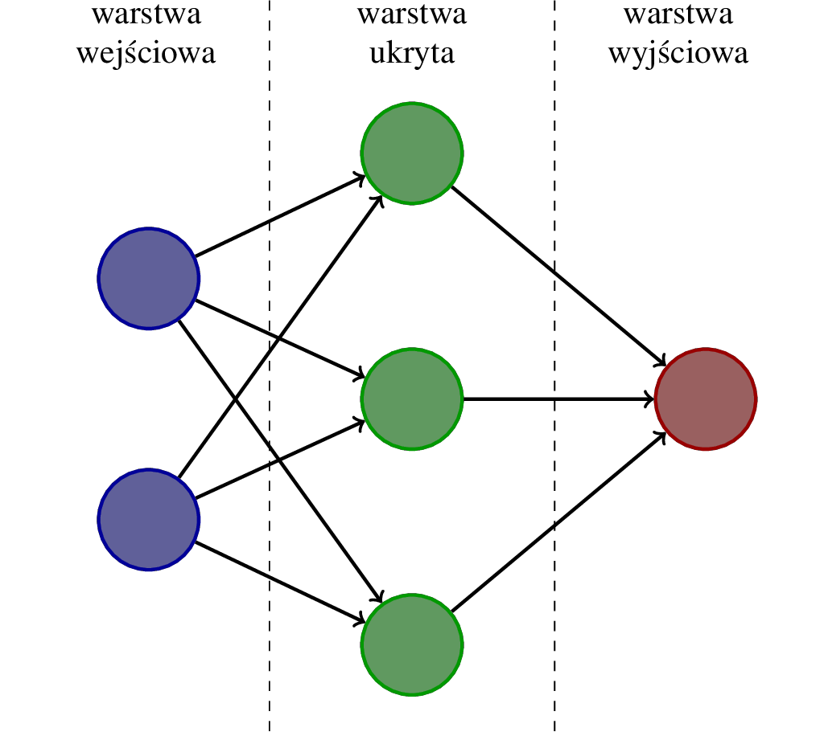


Sztuczne sieci neuronowe

Slide 5
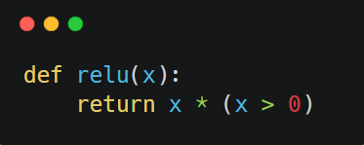
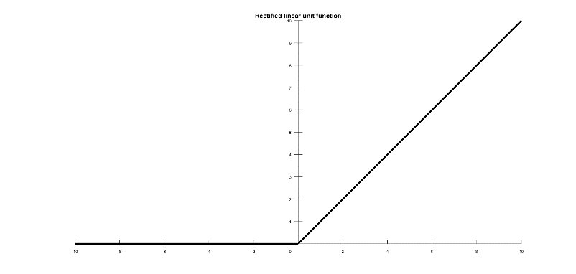
Sztuczne sieci neuronowe
Wejście
-0.1
1.3
2
2
2.1
-0.3
1.1
-0.2
3
3
3.0
-2.4
-0.3
wagi
Funkcja aktywacyjna

Slide 6
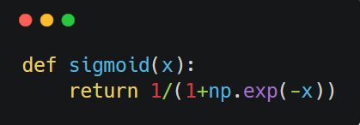
Funkcja aktywacyjna

Slide 7
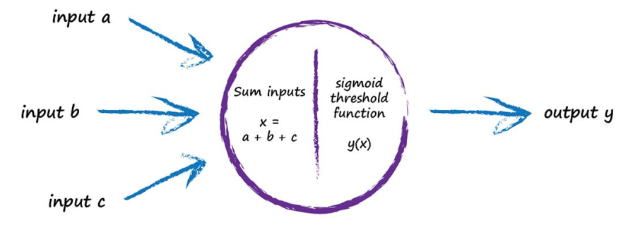
Jak działa sztuczny neuron?
2
2.1
f(x)
-0.2
3
1. (input1 * weight) + (input2 * weight)
(2 * 2.1) + (3 * -0.2) = 4.2 – 0.6 = 3.6
2. activation function (reLU)
f(3.6) = 3.6

Slide 8
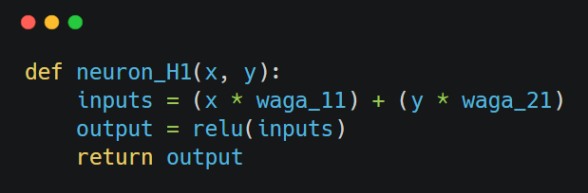
Neuron w warstwie ukrytej

Slide 9
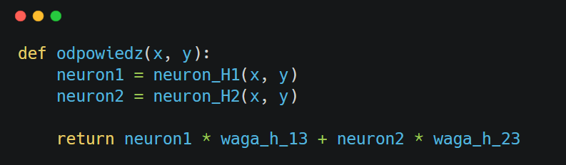
Odpowiedź sieci

Slide 10
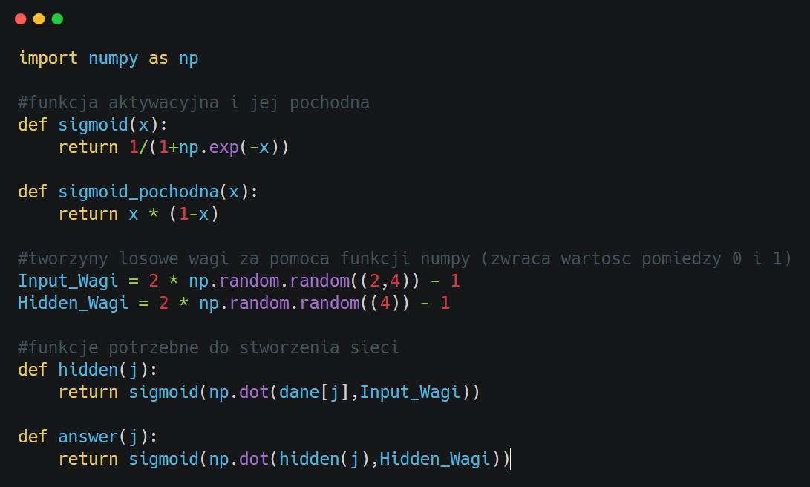
Sieć neuronowa

Slide 11
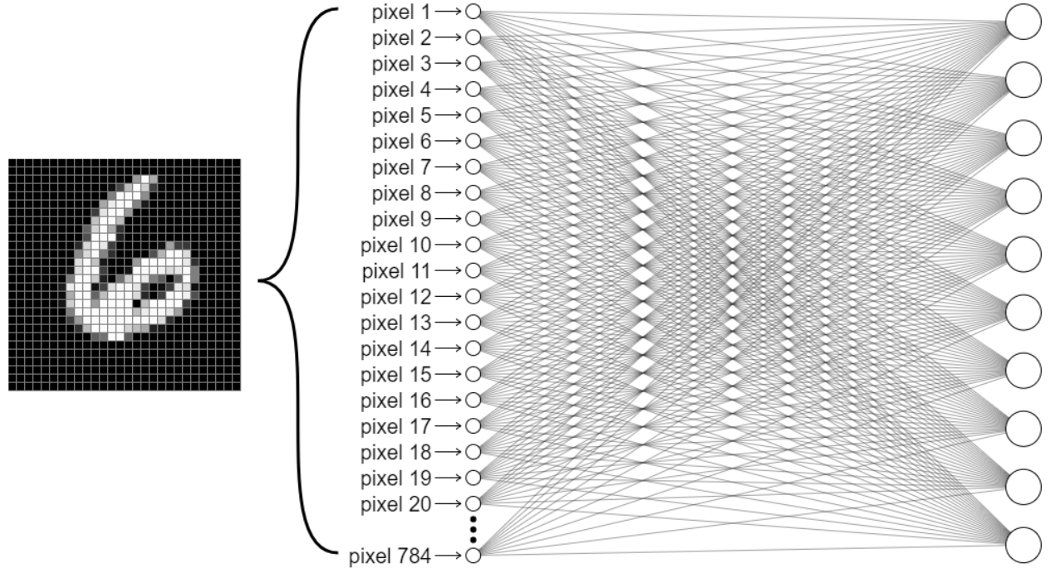
System w działaniu
2

Slide 12
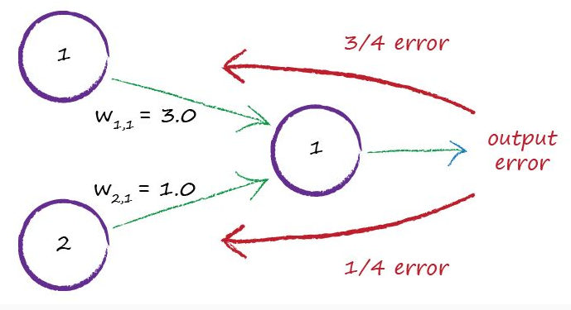
W jaki sposób sieć się uczy?

Slide 13
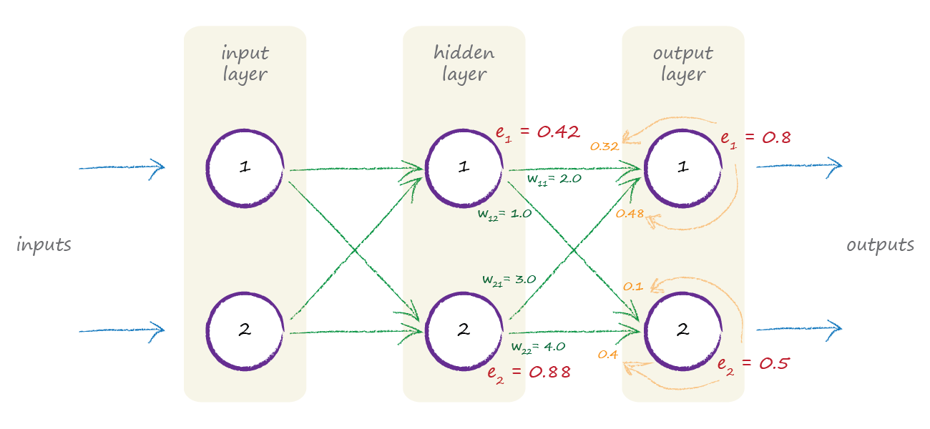
W jaki sposób sieć się uczy?

Slide 14
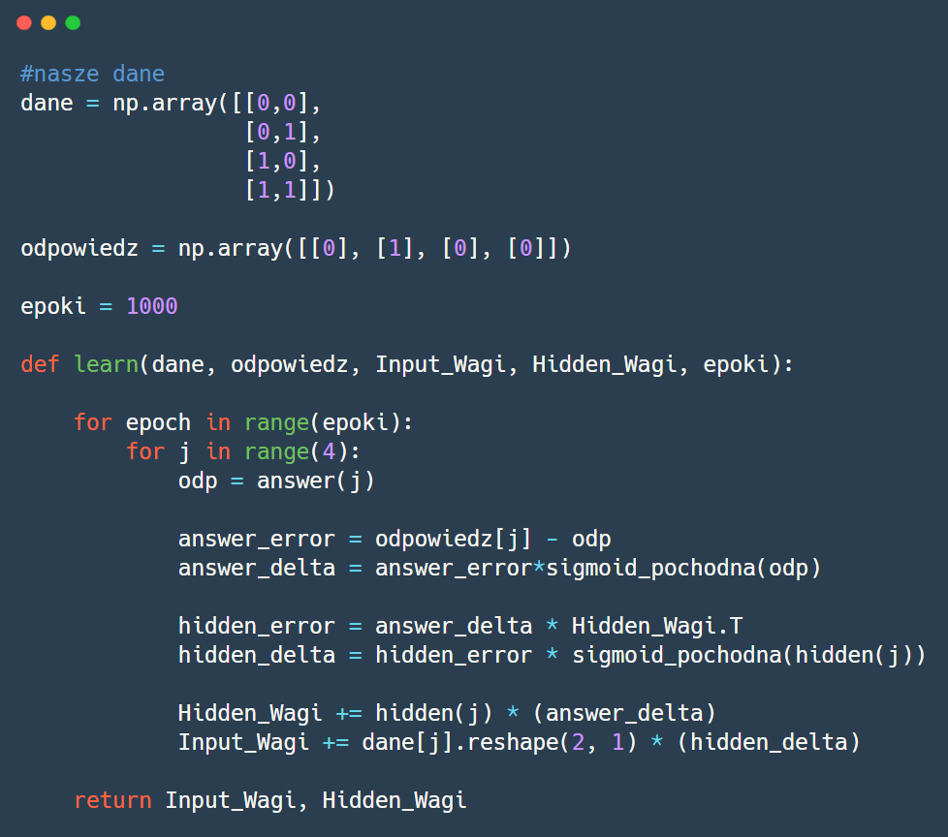
W jaki sposób sieć się uczy?

Slide 15
5 epok (250 000 cyfr) później
6

Slide 16
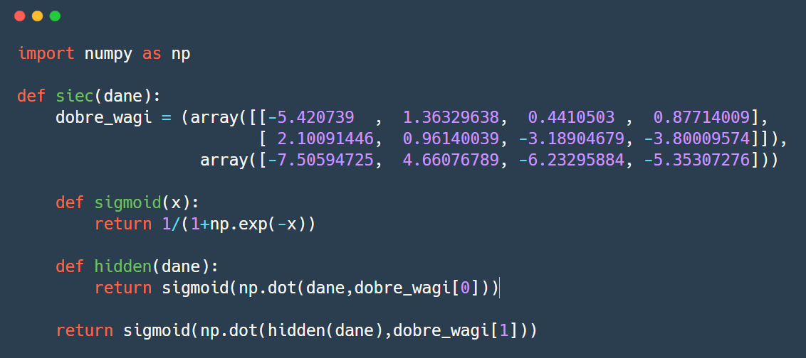
5 epok (250 000 cyfr) później

Slide 17
TensorFlow i Keras
2

Slide 18

Biblioteka TensorFlow
Google’s library for ML
Expresses calculations as a computation graph
GPU/CPU Support
Many language bindings
Supports/provides pre-trained models

Slide 19
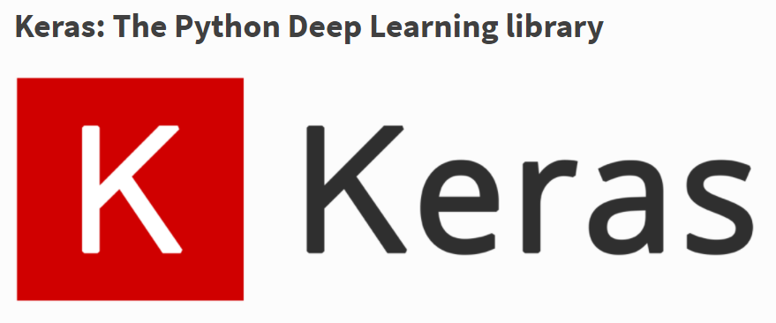
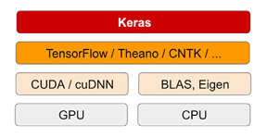
Biblioteka Keras
Neural Network library written in Python
Design to be simple and straightforward
Built on top of different deep learning libraries such as Tensorflow (Google), Theano (UM) and CNTK (MS)

Slide 20
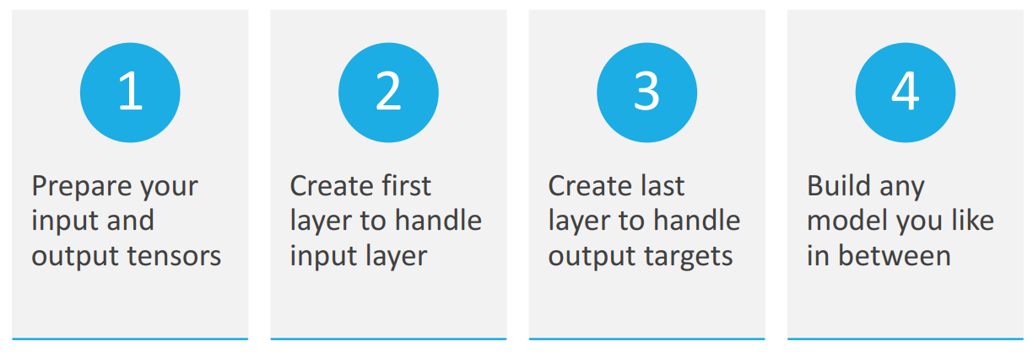
Keras workflow

Slide 21
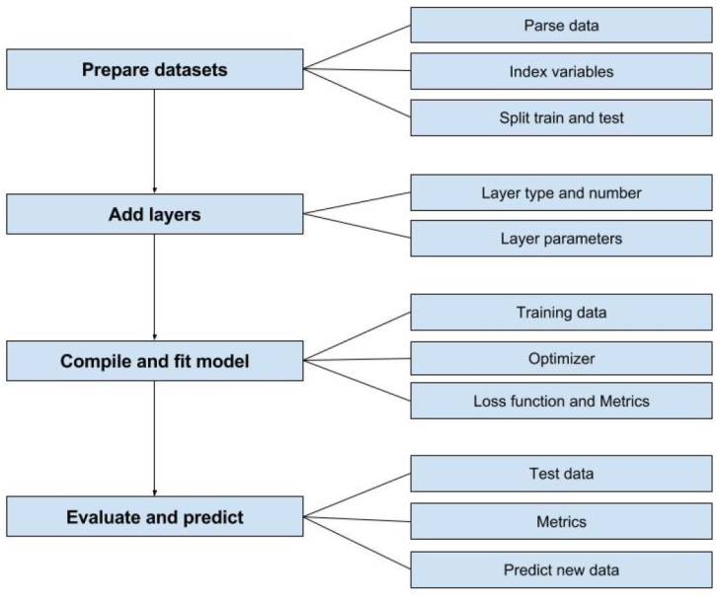
Keras workflow

Slide 22
Keras in 30 seconds
3

Slide 23
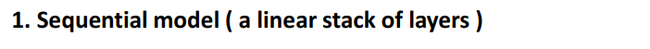
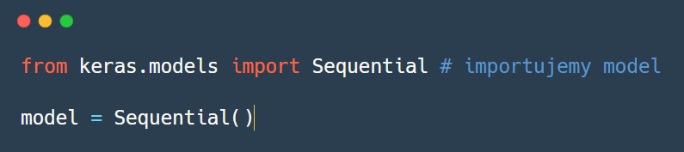
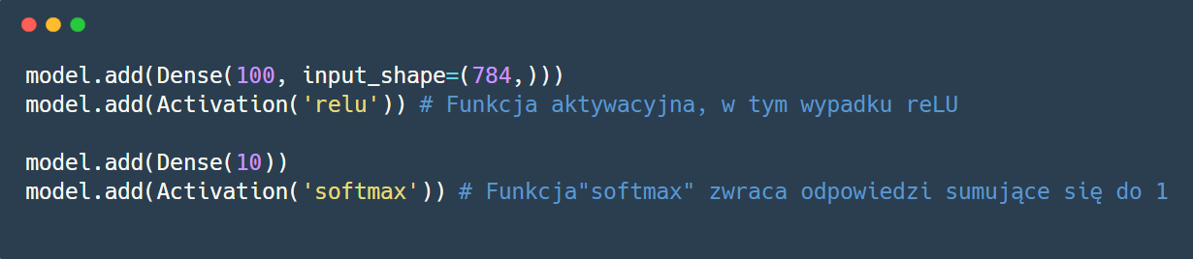
Keras w 30 sekund

Slide 24
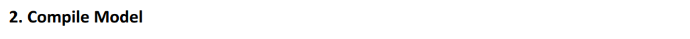
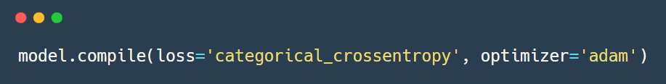
Keras w 30 sekund

Slide 25
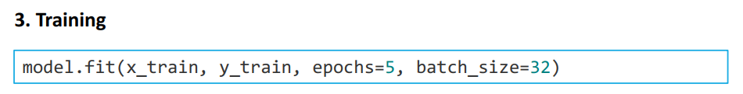
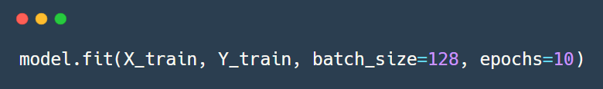
Keras w 30 sekund

Slide 26
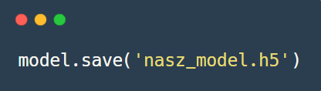
Keras w 30 sekund

Slide 27
Keras: kluczowe definicje
4

Slide 28
Keras Terminology
Sequential
Dense
Activation
Optimizer
Loss
Epochs
Dropout
Notes:
Look for ‚five pairs’

Slide 29

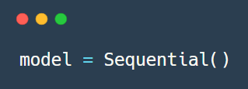
Keras Terminology
Sequential
A set of layers connected in series
Layers connected in a sequence.
Notes:
Look for ‚five pairs’

Slide 30
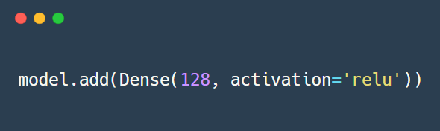
Keras Terminology
Dense
Densely connected layers, where every node is connected to every other node
Each node in each layer is connected to every other node in the next layer.
Notes:
Look for ‚five pairs’

Slide 31
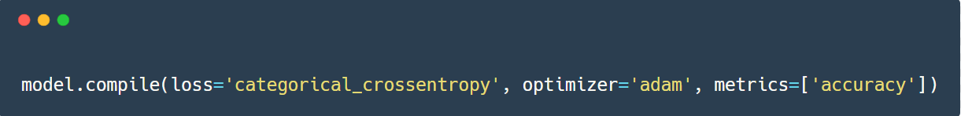
Keras Terminology
Optimizer
the mechanism through which the network will update itself (based on the data it sees) to minimize its loss function.
Optimization algorithms for network: (SGD (Gradient Descent), Adam, etc.)
Notes:
Look for ‚five pairs’

Slide 32
Keras Terminology
Loss Function
Method of calculating errors
Mean squared error
Binary cross-entropy
etc.
Notes:
Look for ‚five pairs’

Slide 33
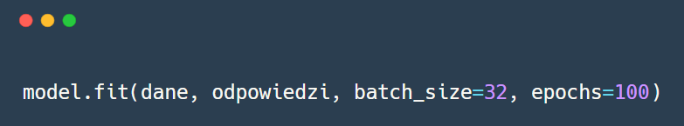
Keras Terminology
Epoch
One pass over the full data set
More passes = more refined
Notes:
Look for ‚five pairs’

Slide 34
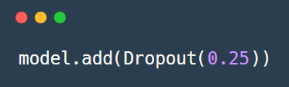
Keras Terminology
Dropout
The term refers to dropping out units in a neural network (we temporarily remove them from the network, along with all its connections). The choice of which units to drop is random (each unit is removed with a fixed probability)
Notes:
Look for ‚five pairs’

Slide 35
Sieci konwolucyjne
5

Slide 36

Konwo.. co?

Slide 37
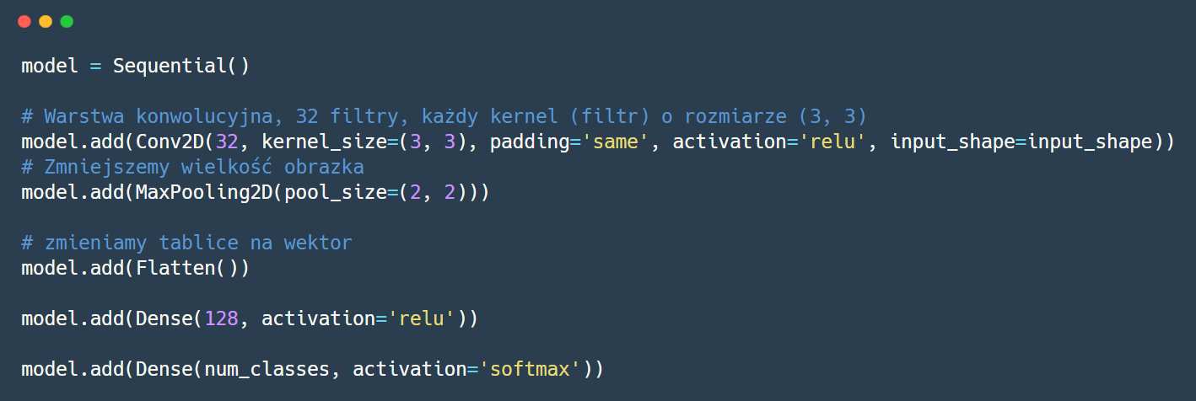
Sieć konwolucyjna w keras

Slide 38
AI we wdrożeniach
6

Slide 39
Trening vs. inference
Training
Human
Bicycle
Forward
“Strawberry”
?
“Bicycle”
Lots of labeled data!
Backward
Error
Strawberry
Model weights
Inference
Forward
“Bicycle”?
??????

Slide 40
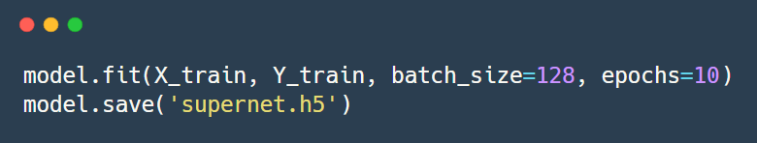
Trening vs. inference
Training
Human
Bicycle
Forward
“Strawberry”
?
“Bicycle”
Lots of labeled data!
Backward
Error
Strawberry

Slide 41
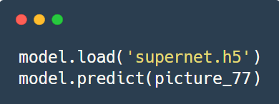
Trening vs. inference
Inference
Forward
“Bicycle”
??????

Slide 42
AI i hardware
7

Slide 43
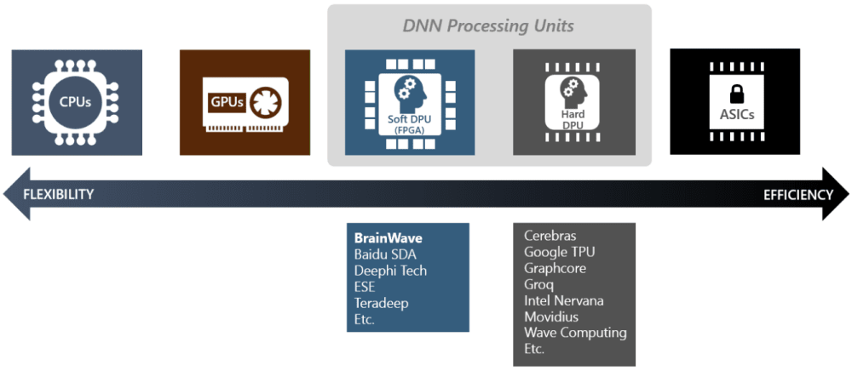
Różne metody wdrożenia ML na poziomie sprzętowym

Slide 44
Pytania?

Slide 45
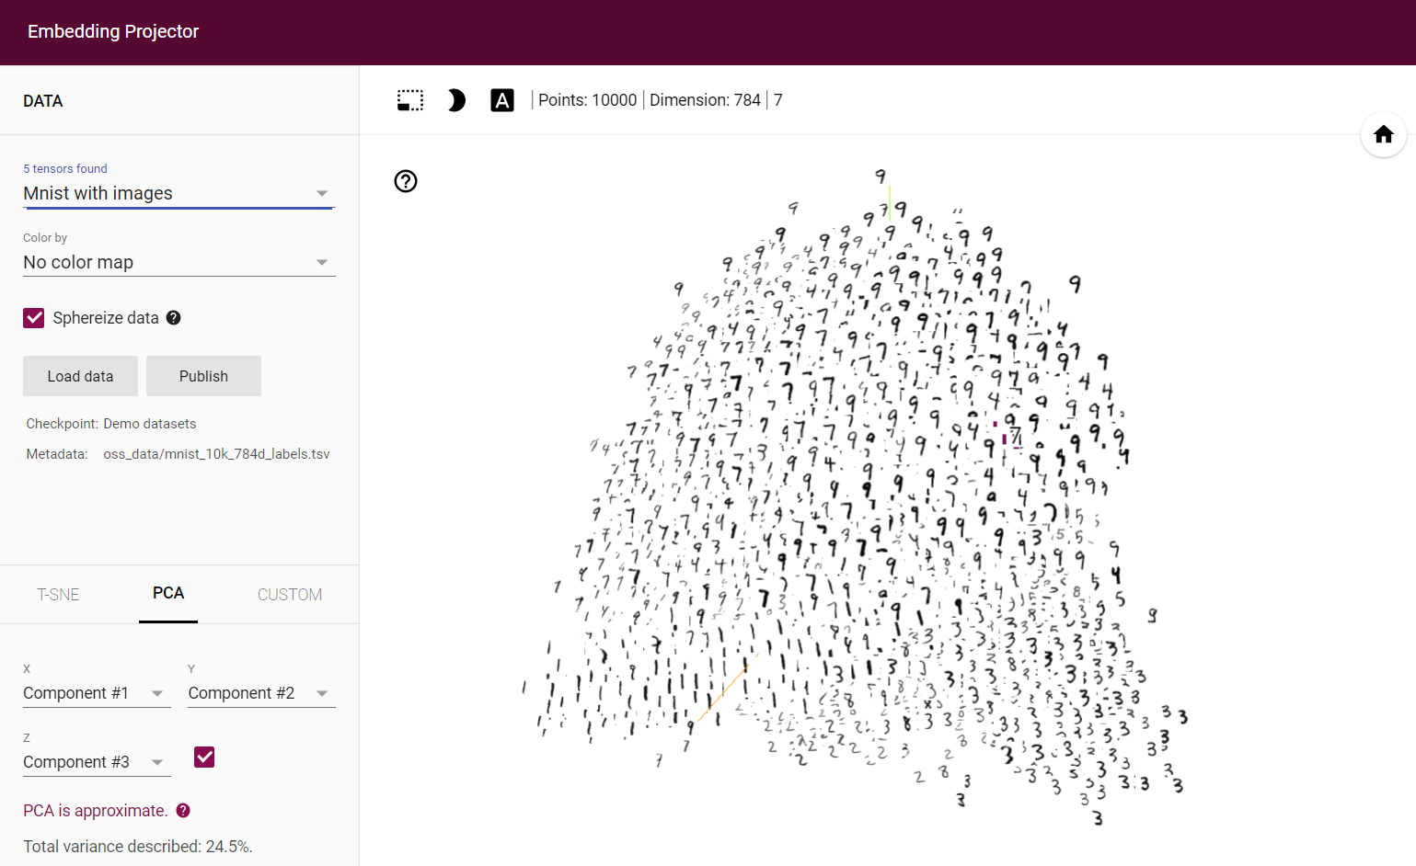
Word vectors

Slide 46
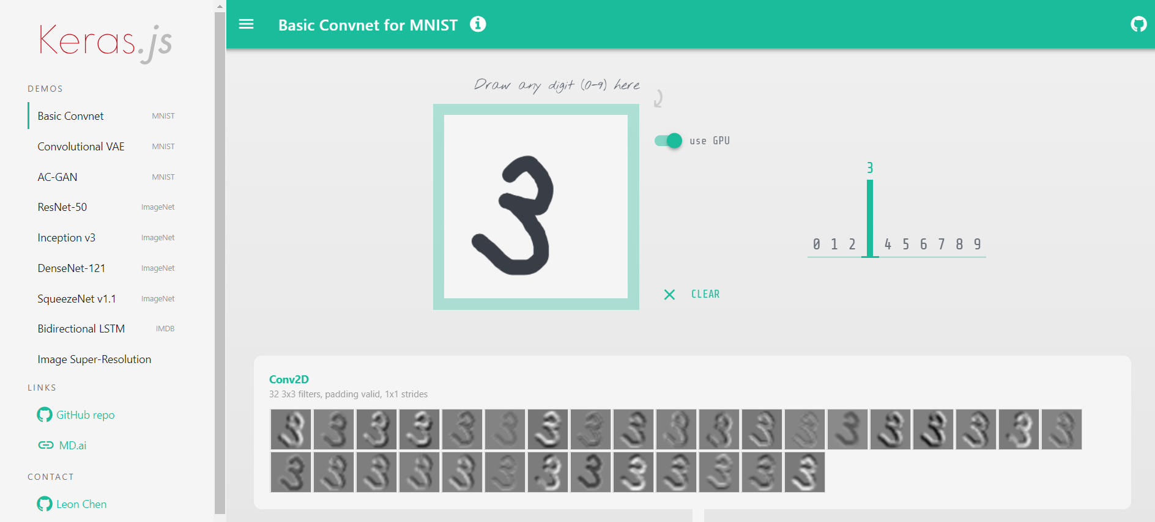
Keras demo

Slide 47
Pytania?

